Slide 1
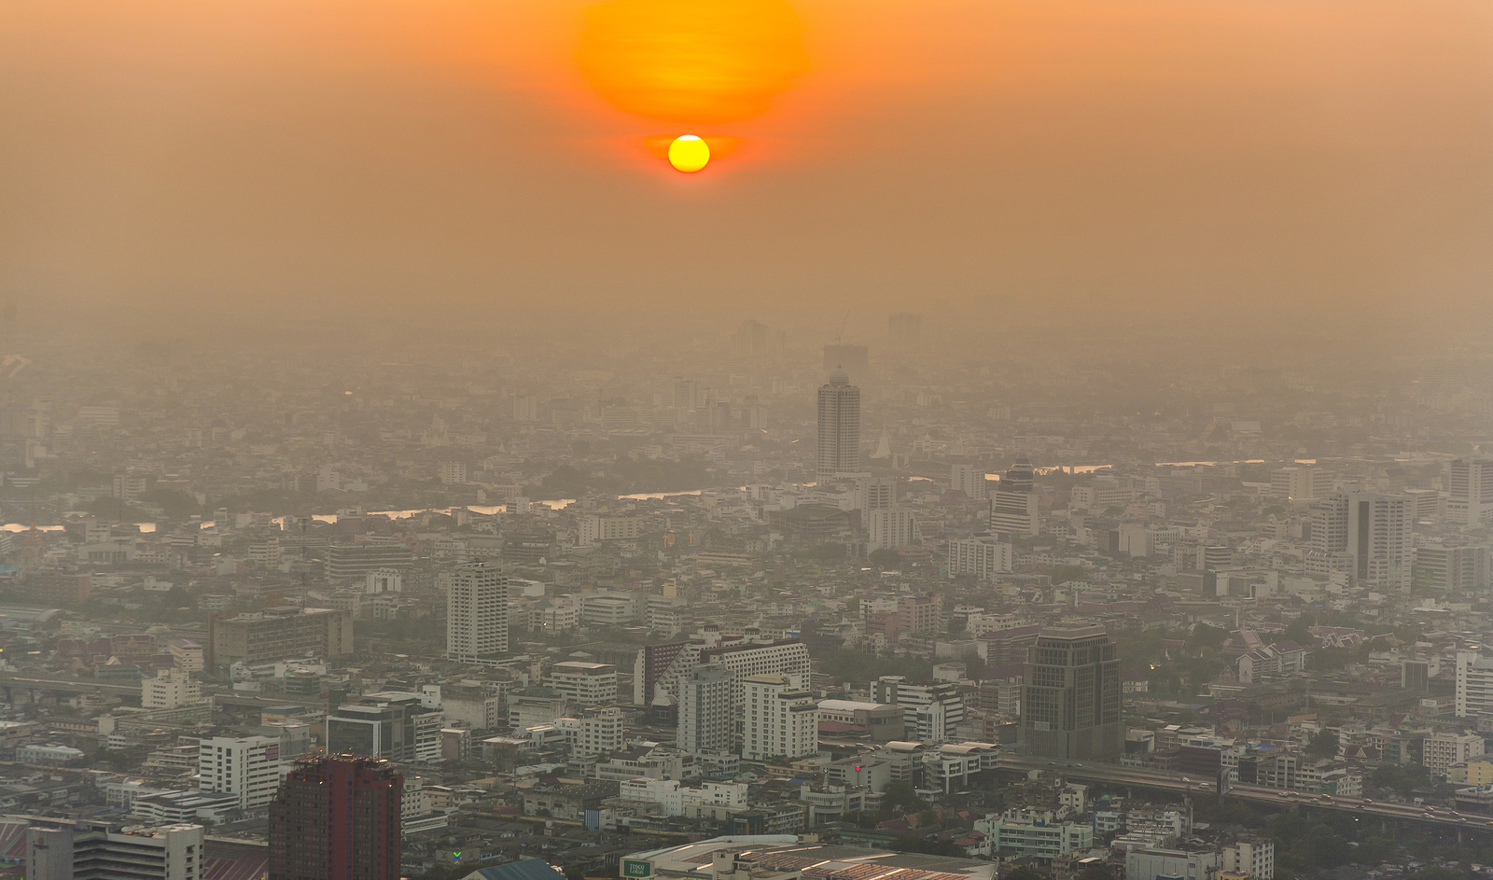
Outdoor air pollution
Robert G. Hendrickson, MD
Oregon Poison Center
Oregon Health and Science University
Portland, Oregon, USA

Slide 2
Consider this day…
You are working in an emergency department (ED)
On the way to work, your eyes are watering a bit and you develop a mild cough
In the ED:
  100% increase in patients today
  4X the number of intubations today
  ICUs are full
  Only a few ventilators left in the hospital

Slide 3
Consider this day…
What is going on?
  Industrial release?
    Chlorine, ammonia, ?
  Terrorist attack?
    Nerve agent?
    Vesicants?
  No pattern to the patients, no common exposure except that they all live in the local city…

Slide 4
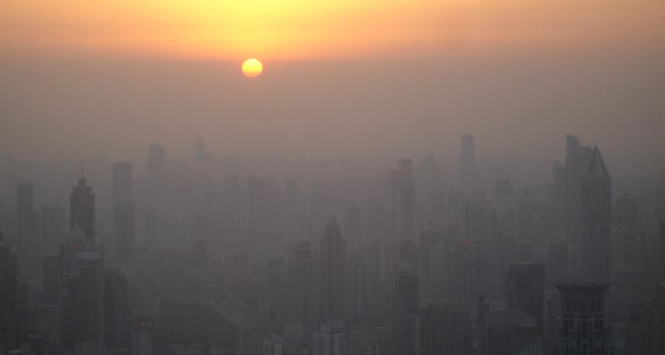
Notes:
Shanghai

Slide 5
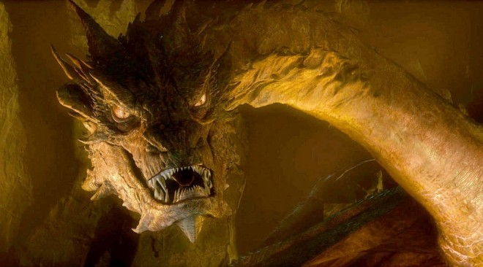
Outdoor air pollution
What is outdoor air pollution?
  Gases & fine particles produced from natural and man-made activities
  Smog = used to describe mixture of smoke/pollution and fog

Slide 6
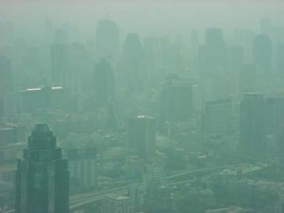
Bangkok

Slide 7
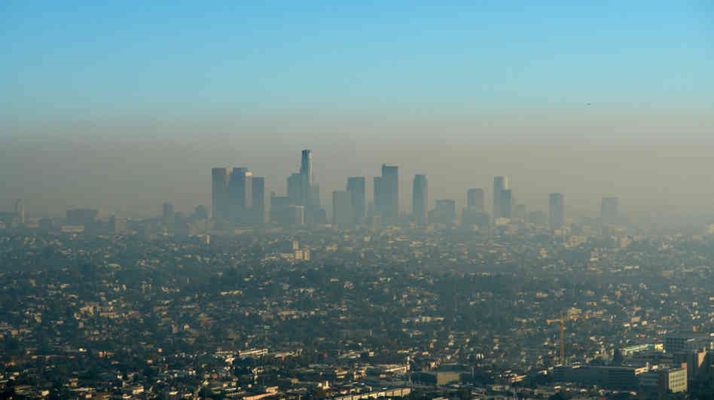
Los Angeles, USA

Slide 8
Outdoor air pollution
What is outdoor air pollution?
  Oxides of nitrogen (e.g. nitrogen dioxide, NO₂)
  Sulfur dioxide (SO₂)
  Ozone (O₃)
  Carbon monoxide (CO)
  Particulate matter (PMs)
  Lead, metals, and other hazardous air pollutants (HAPs) or “air toxics”

Slide 9
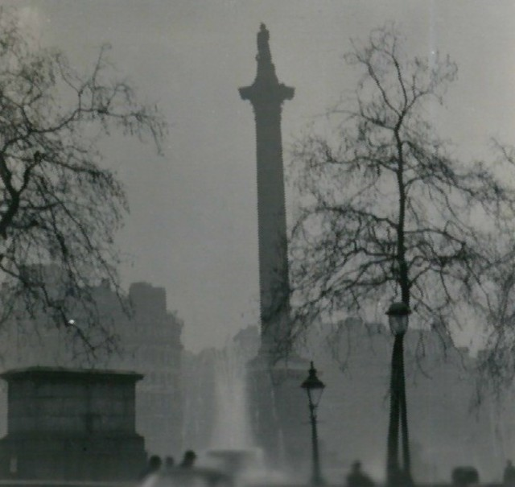
Outdoor air pollution
London, Dec 5-9, 1952
  Great Smog of ’52
  Sulfur dioxide
  4-12,000 deaths
  100,000 made ill
"Nelson's Column during the Great Smog of 1952" by N T Stobbs. Licensed under CC BY-SA 2.0 via Commons - https://commons.wikimedia.org/wiki/File:Nelson%27s_Column_during_the_Great_Smog_of_1952.jpg#/media/File:Nelson%27s_Column_during_the_Great_Smog_of_1952.jpg
Notes:
Cold weather = more coal burning
Anticyclone = windless London and temperature inversion
Visibility decreased to 1 meter – difficult to walk outside
Smog penetrated indoors and theaters closed

Slide 10
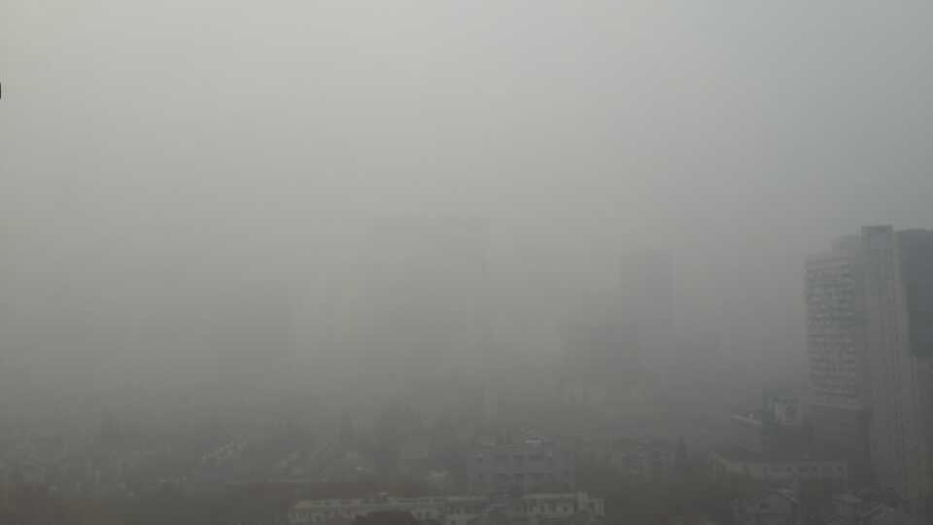
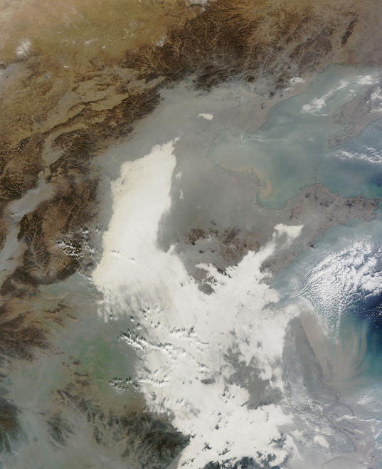
Outdoor air pollution
Eastern China, 2013
  Shanghai
  Tianjin
AQI = 507
Airports, highways closed due to poor visibility
"Shanghai haze in Huangpu Distract 20131206" by Galaxyharrylion - Own work. Licensed under CC BY-SA 3.0 via Commons -
by Jeff Schmaltz - NASA Earth Observatory. Licensed under Public Domain via Commons -
Notes:
AQI >300 = dangerous to all humans
inversion

Slide 11
Primary pollutants
Sulfur dioxide
Nitrogen dioxide
Carbon monoxide
Volatile organic compounds (VOCs)
Hazardous air pollutants (HAPs)(e.g. lead, etc)
Notes:
VOCs – released from burning fuel. Some examples: formaldehyde, benzene, toluene, styrene, xylene, perchloroethylene.

Slide 12
Secondary pollutants
Pollutants that are formed from chemical or photochemical reactions of primary pollutants
  Ozone (VOCs + NO_{x} -> ozone)
  Nitric acid (HNO₃)
  Formaldehyde
  Particulate nitrate (acid rain)
  Particulate sulfate (acid rain)

Slide 13
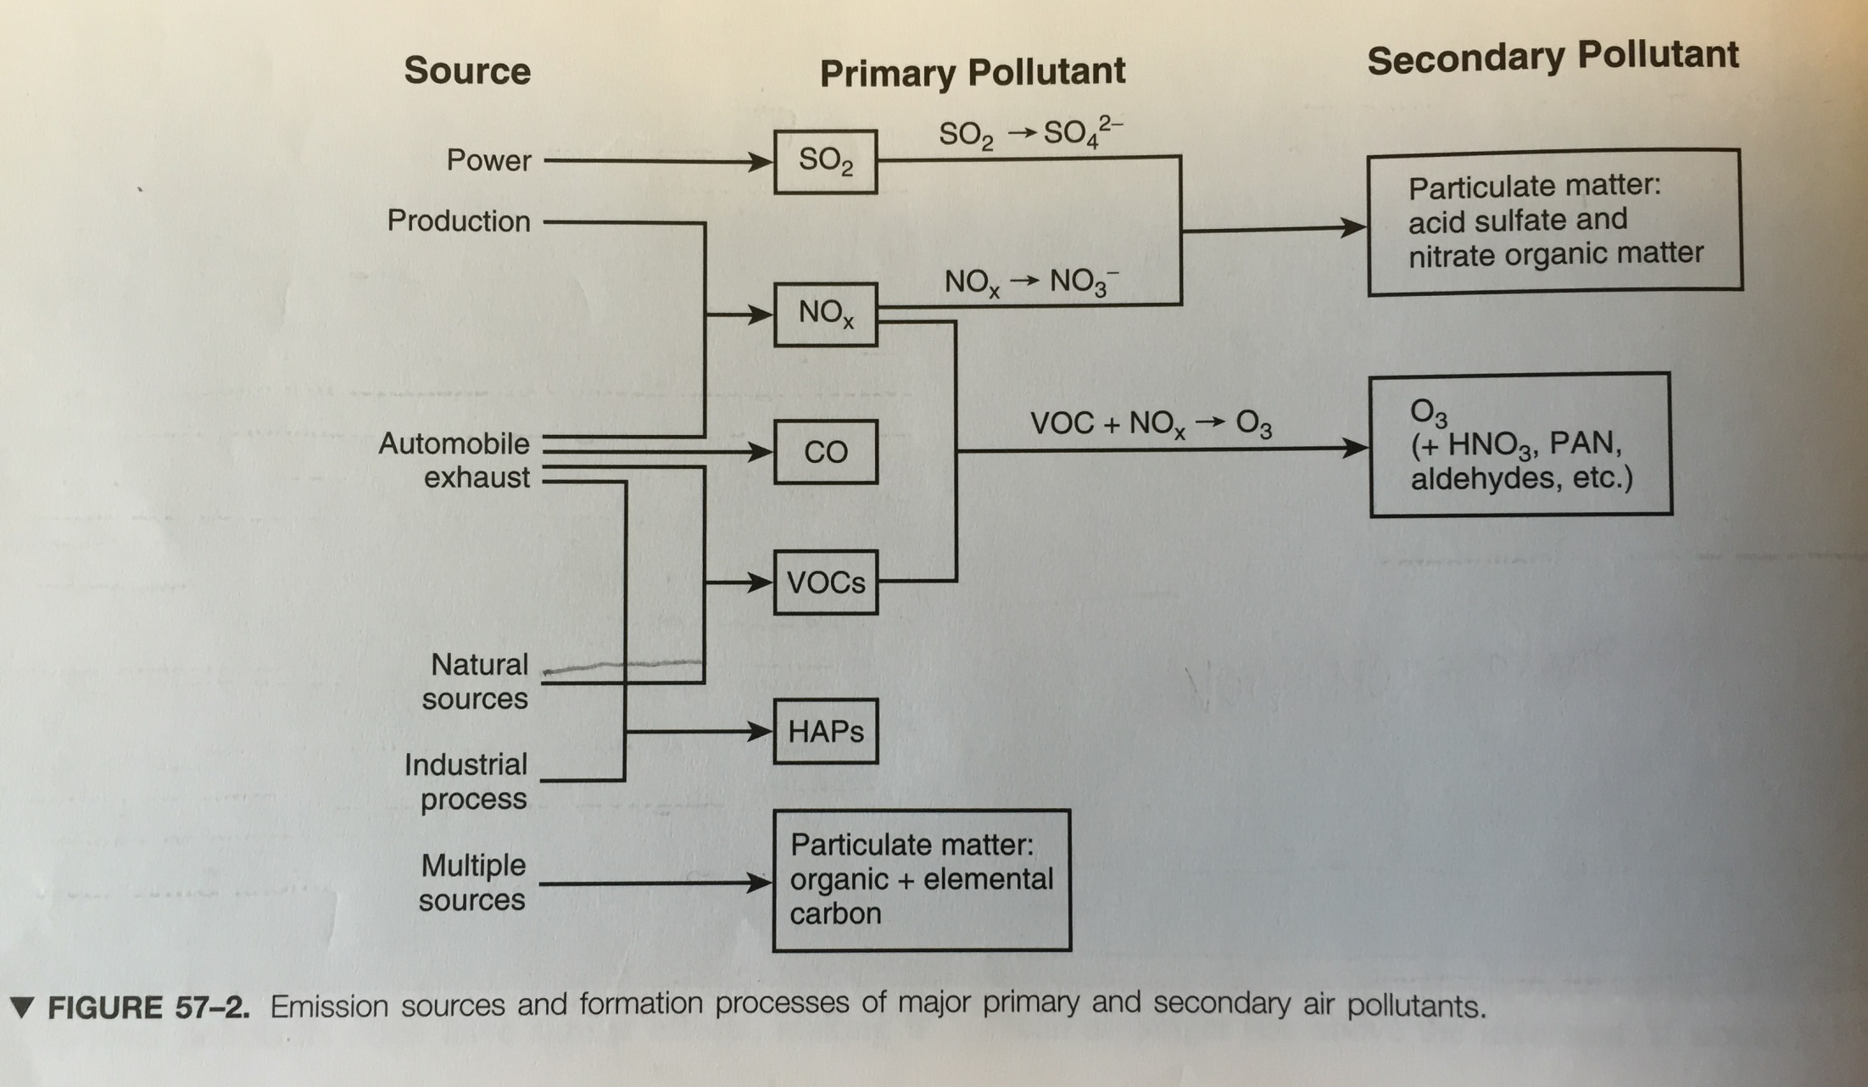
Greenberg MI, ed. Occupational, industrial, and environmental toxicology, 2nd edition. Mosby, 2003

Slide 14
Individual agents
Sulfur dioxide (SO₂)
Oxides of nitrogen (e.g. nitrogen dioxide, NO₂)
  Acid rain
Ozone (O₃)
Carbon monoxide (CO)
Particulate matter (PMs)
Lead, metals, and other hazardous air pollutants (HAPs) or “air toxics”

Slide 15
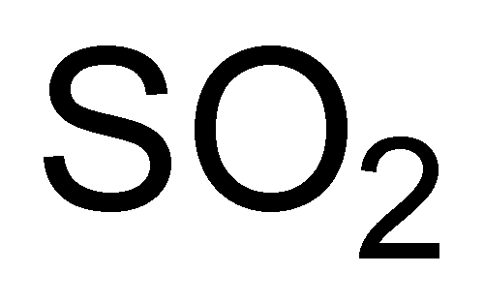
Sulfur dioxide
Primary source = coal power plants
Sulfur dioxide(SO₂) -> sulfuric acid (H₂SO₄)
  In atmosphere and in respiratory tract
Water soluble irritant gas
  Upper airway deposition
  Produces sulfurous acid, bisulfite, sulfite, and H₂SO₄
    Bronchoconstriction (bisulfite)
    Upper airway irritation
    Inflammatory/immune responses - sensitizer

Slide 16
Nitrogen dioxide
Primary source is automobiles, then power generation, biomass burning(local)
N2 and O2 combine to form Nox
NO2 combines with water in lungs to form nitrous acid and nitric acid
  Bronchospasm/airway hyperresponsiveness
  Increased susceptibility to airway infections (chronic)

Slide 17
Sulfur dioxide and nitrogen dioxide
Non-medical, environmental effects

Slide 18
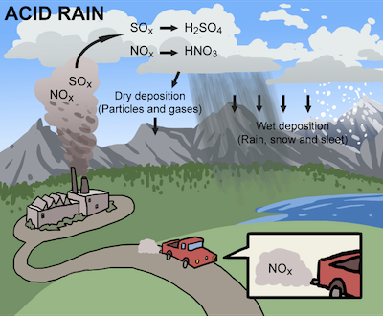
Acid Rain

Slide 19
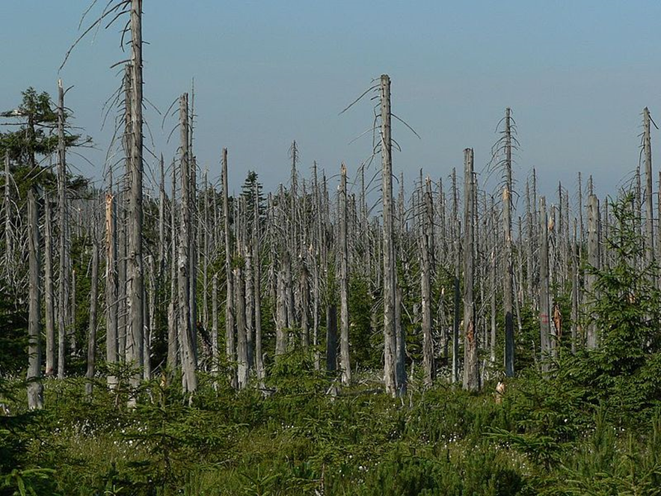
Acid rain

Slide 20

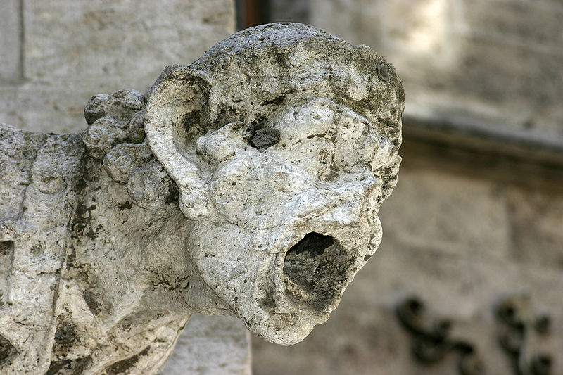
Acid rain

Slide 21
Ozone
Stratospheric (“good”) ozone
Ground-level (“bad”) ozone
  Created by reaction of NOx and VOCs and sunlight
    NOx released from energy production
    VOCs released from energy production, automobiles, and natural sources
      Ozone generally highest in afternoon w/ sunny weather (summer)
Remains the most violated environmental standard in the United States
Main component of smog

Slide 22
Ozone
Health effects:
  Low water solubility – alveoli
  Irritant and oxidant -> pulmonary inflammation
    Bronchospasm (cough, wheeze, chest tightness)
    Decreased FVC and FEV1
  Short term:
    Increases in admissions for pneumonia, COPD, asthma, respiratory complaints
      Reversible (decreased asthma complaints in Atlanta, US after reduced traffic/ozone during Olympic games)
    Increased mortality rates on days with high ozone from cardiopulmonary disorders
  Long-term -> increased chronic respiratory illnesses (in lab animals)

Slide 23
Carbon monoxide
Primary source = automobiles
Systemic effects:
  Decreases oxygen delivery
Acute toxicity
Chronic toxicity:
  Increased events in patients with chronic cardiopulmonary diseases: angina, MI.

Slide 24
Particulate matter (PMs)
Solid and liquid components of airborne aerosol
  Acid sulfate and nitrates formed from SO₂ and NO_{x}
  Ammonium nitrate and sulfates
  Particulates from diesel exhaust, wood burning, dust, road surfaces, and elemental carbon

Slide 25
Particulate matter (PMs)
Large particles > 10 µm
  Deposit in upper airways
Coarse particles = 2.5-10 µm (PM10)
  Airborne dust, crustal elements (silicon, aluminum)
  Deposit in lower airways
Fine particles < 2.5 µm (PM2.5)
  Acid sulfates and nitrates
  Deposit in alveoli & have systemic effects
Total suspended particulates (TSP)

Slide 26
Particulate matter (PMs)
Health effects:
  PM10 associated with:
    Increases in asthma and COPD exacerbations

Slide 27
Particulate matter (PMs)
Health effects:
  PM2.5 associated with:
    Increased mortality
    PM2.5 concentration correlates with
      Increased histamine release in airways
      Reduced macrophage activity in lungs (decreased response to infection?)
      Decreased heart rate variability (marker for MI risk)
      Increased ICD discharges
      Increased plasma viscosity

Slide 28
Particulate matter (PMs)
Harvard Six Cities Study
For each 10µg/m3 increase in PM2.5:
  1.5% daily increase in mortality
  3.3% daily increase in COPD deaths
  2.1% daily increase in ischemic heart disease deaths

Slide 29
Hazardous air pollutants (HAPs)
US EPA introduced HAPs in 1997
189 chemicals
  VOCs
  Metals
  Important chemicals: benzene, arsenic, lead, mercury

Slide 30
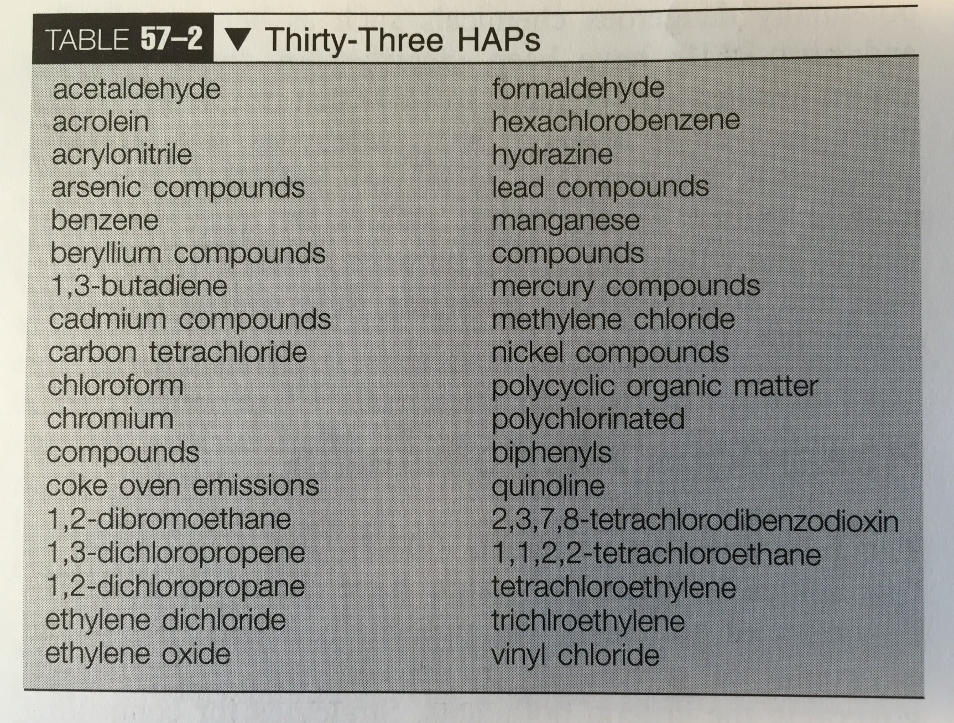
Hazardous air pollutants (HAPs)
33 HAPs that are “most hazardous to human health”

Slide 31
Patterns of air pollution
Natural peaks and valleys
  SO₂, CO – cold weather
  NO₂ - mid-day
  O₃ - mid-day, sunny weather (summer)

Slide 32
Air Quality Index
0-500
100 = PEL
AQI = the highest AQI number for any of the pollutants
Non-linear

Slide 33
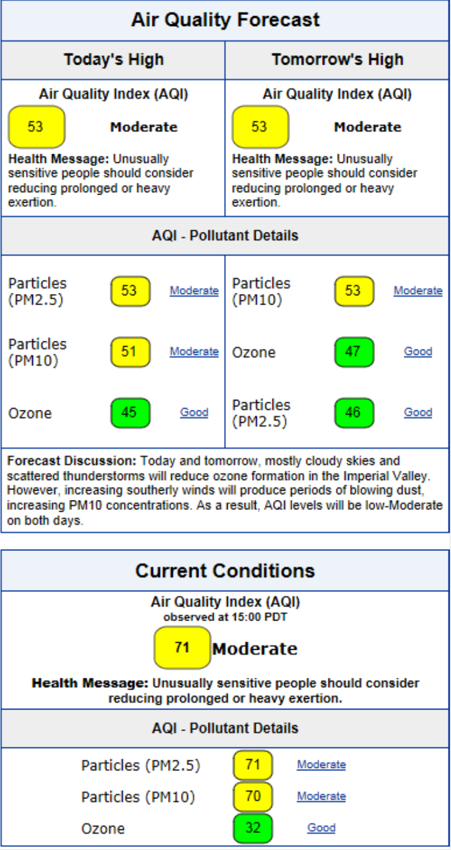
Air Quality Index
0-500

Slide 34
US Regulation
1955, Air Pollution Control Act
1965 Motor Vehicle Air Pollution Control Act
1963 Clean Air Act
  Amended 1970, 1977, 1990

Slide 35
Clean Air Act
Established National Ambient Air Quality Standards (NAAQS) to protect public health
  Primary standards – to protect public health
  Secondary standards – to protect welfare (against decreased visibility and damage to crops, buildings, etc)
  US EPA responsible for establishing and revising
    If a county is designated as a nonattainment area, then the state is mandated to develop a plan to bring the county into attainment
    States also issue permits for large stationary sources of criteria pollutants

Slide 36
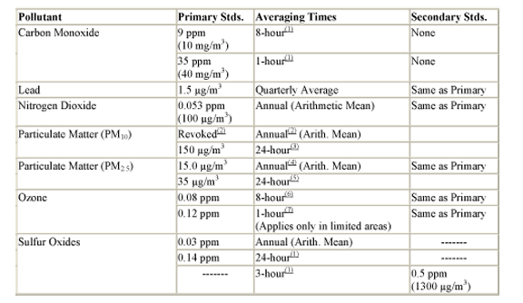
US National Ambient Air Quality Standards

Slide 37
Clean Air Act
Determined “criteria pollutants”:
  NO₂, SO₂, CO, O₃, Lead, PM2.5, PM10
1990 Clear Air Act amendment
  189 additional pollutants (“hazardous air pollutants”, HAPs)
    33 posing the greatest threat to public health
    Phase 1:
      Maximum achievable control technology (MACT)
      Determined by EPA
      Required for all sources of HAPs

Slide 38
Monitoring

Slide 39
Has regulation worked?

Slide 40
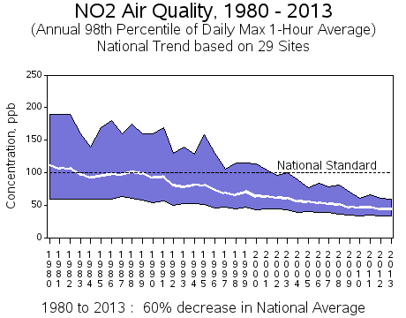
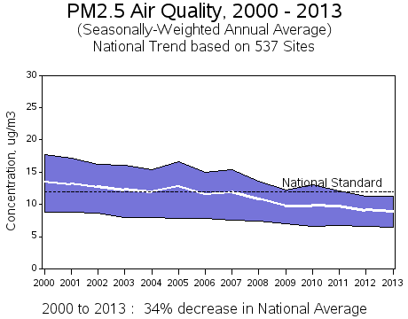
Nitrogen dioxide
PM2.5

Slide 41
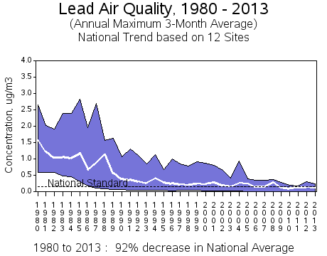
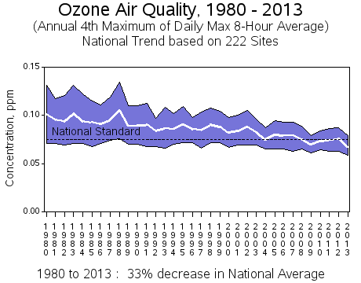
Lead
Ozone

Slide 42
Effective controls for outdoor air pollution
Control of SO₂ requires regulation of coal-fired energy production
  Reduced sulfur coal (and gas and diesel)
  Engineering controls at energy production facilities
Notes:
Thai automobile emissions standards 1995

Slide 43
Effective controls for outdoor air pollution
Regulation of automobile pollution:
Fuel reformulation:
  Leaded gas discontinued
  Decrease benzene content to <3.5%
  Increased oxygen content (MTBE, ethanol)
  Diesel and gasoline sulfur reduction
Automobile emission standards
Notes:
Thai automobile emissions standards 1995
Leaded gas discontinued in 1996

Slide 44
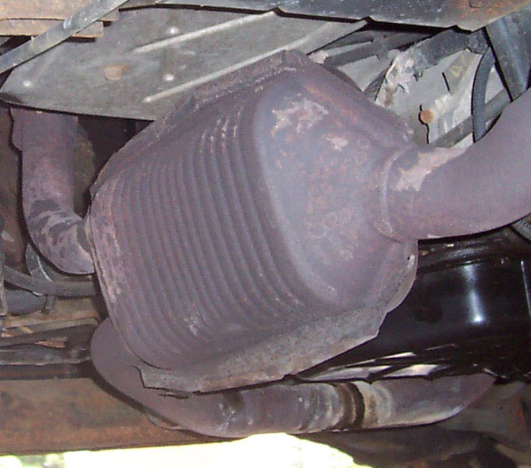
Effective controls for outdoor air pollution
Catalytic converters (1975,1993)
  Catalyze redox reactions
    Combine CO w/ O₂ to form CO₂
    Oxidize unburned hydrocarbons to form CO₂ and H₂O
    “Three-way” CC also reduce NO_{x} to N₂ and O₂

Slide 45
Effective controls for outdoor air pollution
Regulation of fixed site polluters (HAPs)
  Require fixed site polluters to use engineering controls
    Catalytic converters for smoke stacks
    Updating processes
    Finding alternative raw materials or catalysts

Slide 46
Local resources
Monitoring stations
Air Quality – real time reporting

Slide 47
Monitoring

Slide 48
Aqicn.org/city/bangkok/

Slide 49
Thai Air Quality Standards
Pollutant | Time Period | Concentration
SO₂ | Annual | .10 mg/m³ (0.04 ppm)
 | 24 hours | .30 mg/m³ (0.12 ppm)
 | 1 hour | 780 mcg/m³ (0.3 ppm)
NO₂ | 1 hour | 0.32 mg/m³ (0.17 ppm)
 | Annual | 0.057 mg/m³ (0.03 ppm)
PM₁₀ | Annual | 0.05mg/m³
 | 24 hours | 0.12 mg/m³
PM_{2.5} | Annual | 0.025 mg/m³
 | 24 hours | 0.05 mg/m³
O₃ | 8 hours | 0.14 mg/m³ (0.07 ppm)
 | 1 hour | 0.20 mg/m³ (0.10 ppm)
Lead (Pb) | Monthly | 1.5 mcg/m³
CO | 8 hours | 10.26 mg/m³ (9 ppm)
 | 1 hour | 34.2 mg/m³ (30 ppm)

Slide 50
Conclusions
Air pollution:
  Is a complicated mixture of primary pollutant as well as secondary pollutants
  May lead to increases in respiratory complaints/infections as well as increased mortality from respiratory and cardiovascular illnesses
  May be controlled by strict regulation of source polluters and vehicles
  Is monitored in real-time in many locations

Slide 51

QUESTIONS?

